Slide 2

PROJECT 5: IMAGE STYLE TRANSFER
INSTUCTOR: Tran Thi Thanh Hai
Le Thi Lan
GROUP 22:
Nguyen Ba Thanh 20224291
Le Thanh Long 20224325

Slide 3
I. INTRODUCTION

Slide 4
IMAGE STYLE TRANSFORMATION USING CNNs
Separate Content and Style in Images Using Convolutional Neural Networks
Combine the content of one image with the artistic style of another image.
Deliver high-quality visual outputs, providing insights into how neural networks represent images.

Slide 5
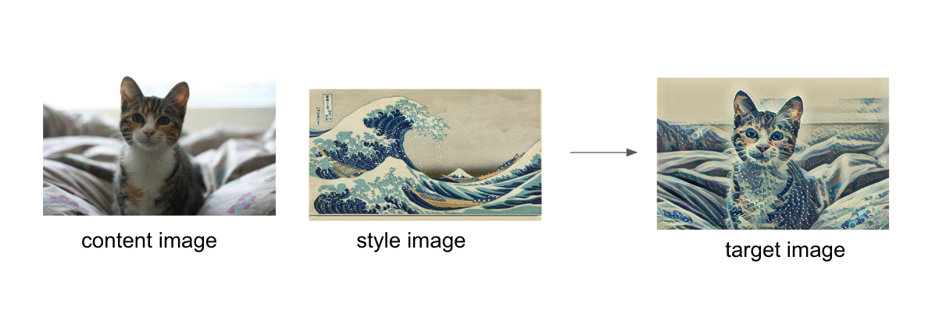

Slide 6
II. PROPOSED METHODS

Slide 7



The method uses a pre-trained VGG19 network to extract and optimize features:
Feature Representation:
Content: High-level features from deeper layers (e.g., conv4_2) represent the structural content.
Style: Gram Matrices of shallow layer features (e.g., conv1_1, conv2_1) capture
correlations representing artistic style.
Loss Functions:
Content Loss: Measures the difference in content features between
the target and content images.
Style Loss: Measures the difference in Gram Matrices between the target and style images.
Total Loss: A weighted combination of content and style losses.

Slide 8


1. VGG
Using VGG-19, pre-trained on the ImageNet dataset, to extract features from the images.
Content Features:
Extracted from the deeper layers of the network, such as conv4_2.
Preserve the structure and main semantics of the original image.
Style Features:
Extracted from multiple layers (e.g., conv1_1, conv2_1, conv3_1, conv4_1, conv5_1).
Represent the relationships between features using Gram matrices.
2. Content Representation
Preserve the key characteristics of the content image.
Content Loss Formula :
3. Style Representation
Capture texture, color, and artistic style.
The formula for the style loss function:

Slide 9

4. Total loss function
Integrating the content loss and style loss:
α,β: Weights adjust the priority between content and style.

Slide 10
III. EXPERIMENT

Slide 11
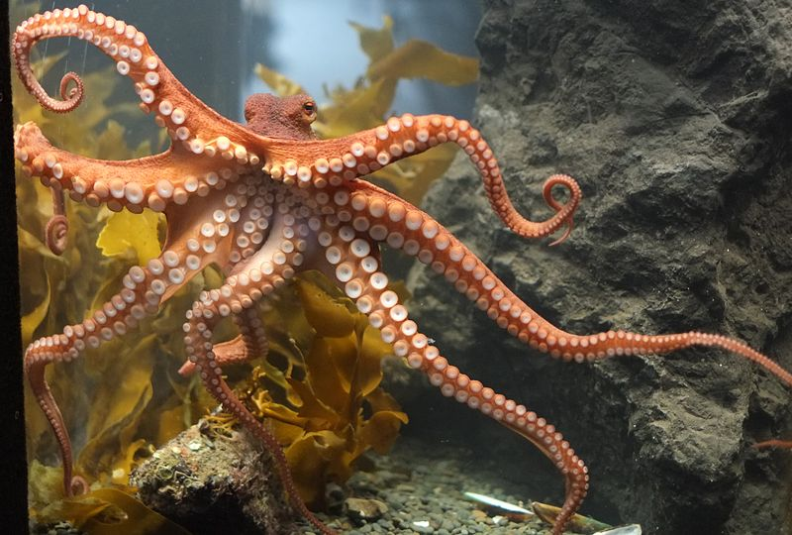
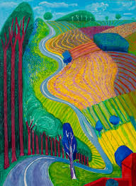
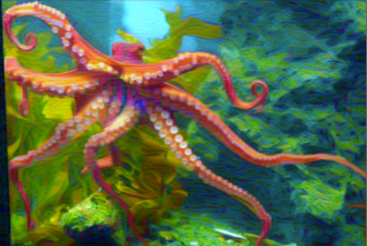
+
→
Content Image
Style Image.
-The achieved result clearly illustrates the combination of content and style:
The content structure (octopus) is well-preserved.
Hockney's artistic style is prominently applied.

Slide 12
IV. CONCLUSIONS

Slide 13
The neural style transfer successfully combines the structural content of one image with the artistic style of another, using VGG-19 to extract features. The content is well-preserved, and the style is vividly applied. This technique offers a versatile tool for creative applications, though future improvements could address efficiency and detail preservation.

Slide 14
THANK YOU !

